Slide 1
AISC1006 STEP 1 PRESENTATION
GROUP D

Slide 2
Agenda
1- Trivia
2- Timeline
3- PipeLine WorkFlow
4- Results
5- Lessons Learned
6- Conclusion
7-Modularization
8-Dashboard Creation

Slide 3

Name of the crypto??
Notes:
Ro

Slide 4

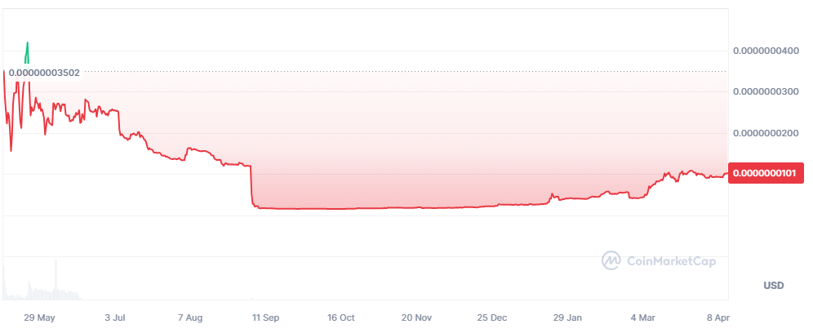

Trumph coin
Notes:
Ro

Slide 5

I can make you rich
Notes:
Ro - Now what if I tell you I come from the future and I know how will a certain crypto will behave for tomorrow, what would you do? Would you trust me? No? that’s why we developed a sophisticated machine learning project so the maths are the ones who speak not us.

Slide 6
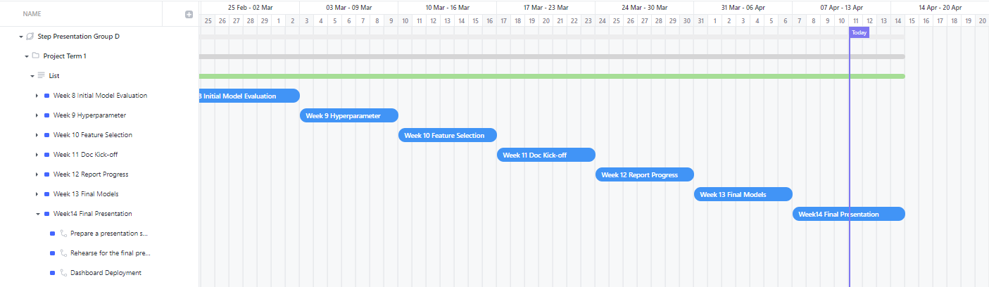
Timeline
Notes:
Ro- Its been a long way, but we made it to the final presentation of this project, i bet everyone is as happy as us, we are just on week 14 to deliver the final results and deliverables.

Slide 7
Recap
Purpose : Predict Litecoin closing price change
Visualizations and exploratory analysis to understand data
Logistic regression and XGBClassifier to model data
Evaluation of model predictions
Notes:
Ro-So lets make a recap of this project, what was our goal or purpose? it was to predict the litecoin change in price day by day, meaning knowing if for tomorrow we will have an increase or decrease with respect today.
Some of the models we started evaluating for our project were Logistic regression and XGB classifier, remember we had an initial approach to use linear regression but as we previously discussed the nature of our data, the volatility of itself, does not make a feasible project to predict the exact price trend, we even showed this on the previous presentation when we showed the results from prophet and we saw the unertainty area was really big and was not following the trend and the peaks from the crypto.
That’s why we included additional models that perform a classification prediction and then we evaluated those models to search the best one.
Now let me continue by sharing some improvements and lessons we took during this journey.

Slide 8
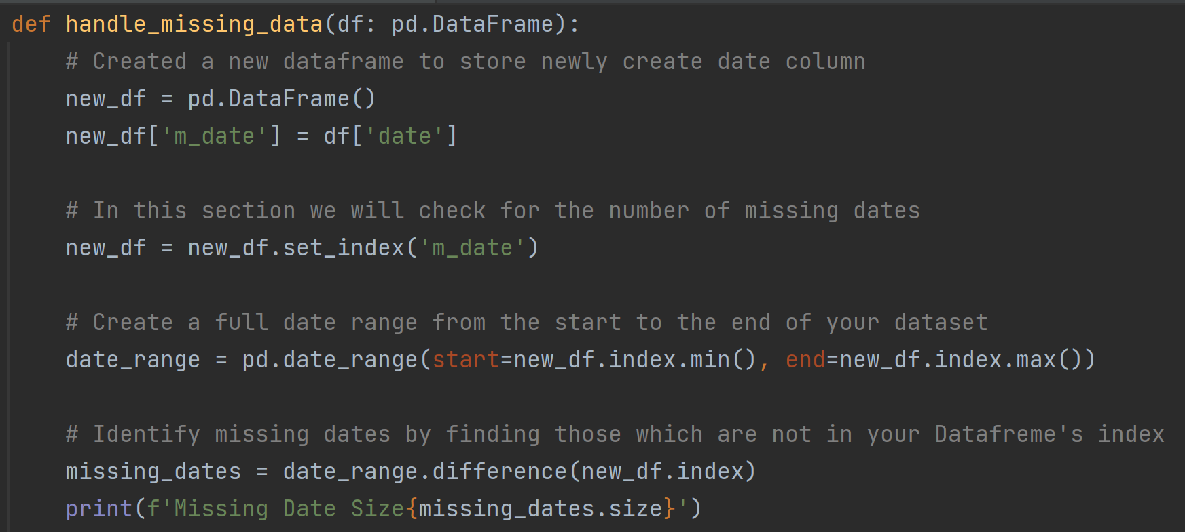
Improvements
Linear interpolation to impute data for missing dates
usual df.describe() , df.isnull()
no missing or null values in the instance of the open, close, high and low prices.
missing rows in the instance of date
Notes:
Janani - Let me explain a little bit of how we identified the missing dates, first we set an index column as our date column, then we check the minimum and maximum index, which will be our first and last date, after that we chek the date range of those 2 dates, and search for the differences, we ended up finding 211 missing dates.

Slide 9
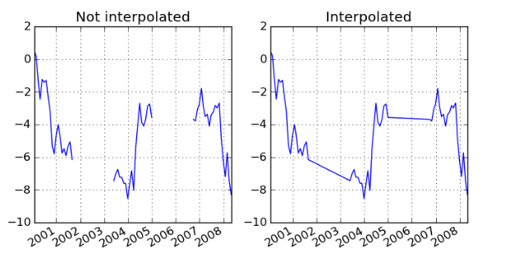
Improvements
Linear interpolation to impute data for missing dates
Linear interpolation is a method used to estimate missing values by filling in the gaps between existing data points.
Notes:
ref: https://pandas.pydata.org/pandas-docs/version/0.7.0/missing_data.html
Janani - Previously we did our usual df.describe() df.isnull() and we felt very lucky because we had no missing values so we continued our model development, but lets not forget that we were comparing the prices from today with the prices from yesterday so if we have missing dates, we can be comparing the prices from today and from 3 weeks ago, and that might not be good for our model.

Slide 10
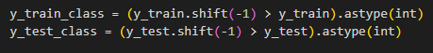
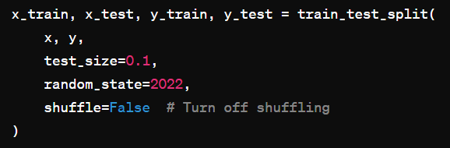
Lessons Learned
Can you spot the issue?
Notes:
ref: https://scikit-learn.org/stable/modules/cross_validation.html
Janani-Do you already catch the issue of using the common train_test_split from sklearn?
That’s right there is a default parameter for shuffle that is set as true, this means our data will be shuffled and on our previous approach this was an issue because our target variables was a engineered feature that shifted the close price so we can predict the price from tomorrow.
So as an alternative we can turn off this parameter to avoid the shuffle, we can split until we reach a certain length of rows as we did in here, one other option could be to use TimeSeriesSplit from our good friend sklearn.

Slide 11
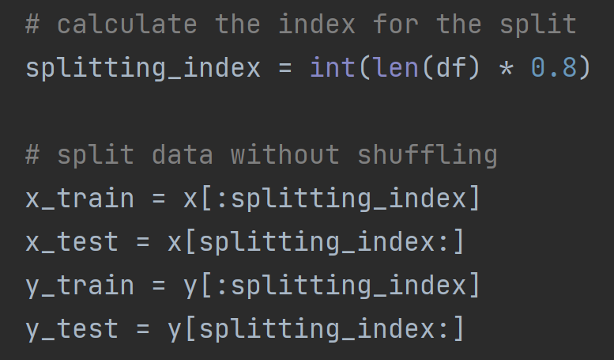
Improvements

Slide 12
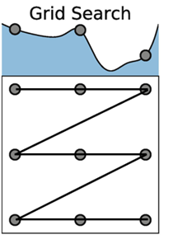
Improvements
Grid search
Find values for hyperparameters of a model in given ranges of values or a distribution of values, for which the model outputs best score
Notes:
ref: https://scikit-learn.org/stable/modules/cross_validation.html Janani-Another improvement we did in our search for better results was the grid search which is a method to iterate over a grid of parameters and return the ones that give the best results for the model, again our good friend sklearn has our back and we can use the method directly from its library. As you can see this is the way in which we need to create the grid.

Slide 13
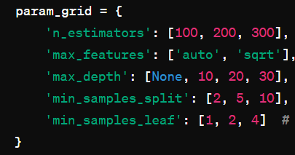
Improvements
Grid search

Slide 14
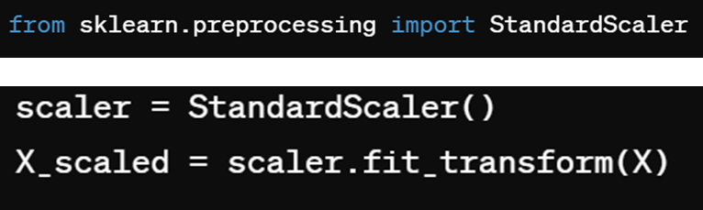
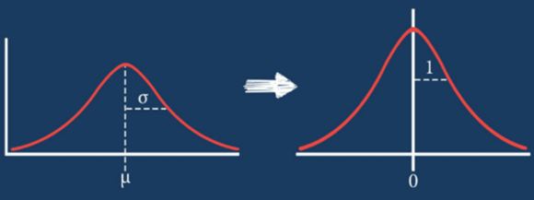
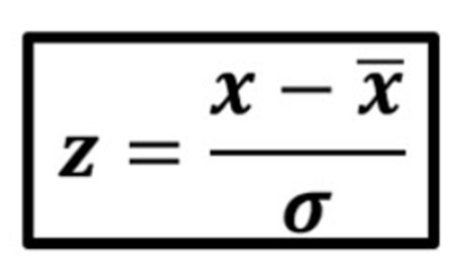
Improvements
Standarization
Notes:
Janani-Another technique to refine our models was using standarization that you probably already know by now, but this is a useful technique for models that use gradient descent for optimization of the cost function. This is basically use Z scores to transform the distribution of our data into a standard form having mean of zero and standard deviation of 1, this can help to the convergence speed of the gradient.

Slide 15
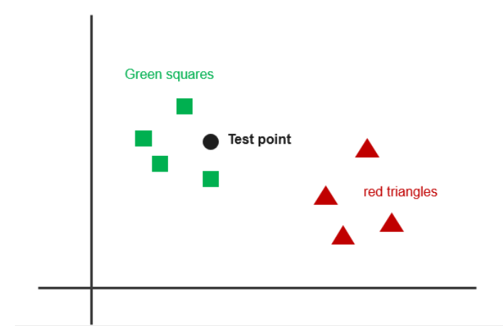
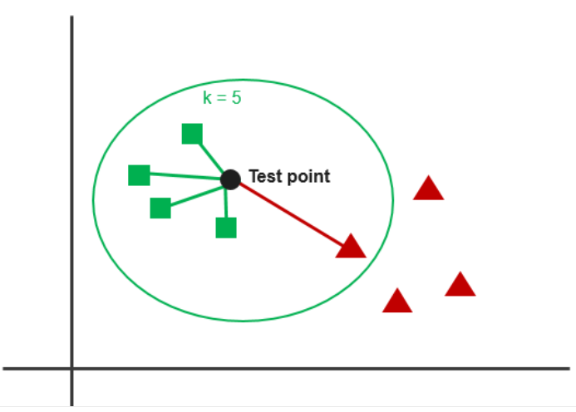
Improvements
Different algorithms to model data
K-nearest neighbours
During the training phase, KNN simply stores the entire training dataset.
When a new data point is presented for prediction, KNN calculates the distances between that point and all other points in the training set and find the nearest K neighbours
Assigns the data point to the class of the majority of these K nearest neighbours
The distance metric commonly used is Euclidean distance
Notes:
Janani

Slide 16
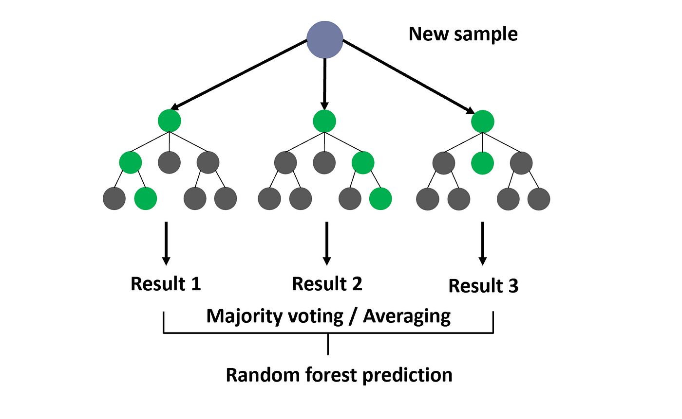
Improvements
Different algorithms to model data - Random Forest Classifier
An ensemble algorithm based on bagging(bootstrap aggregating) technique
Generate multiple trees and uses majority of the classifications to classify a given data point
Notes:
Ro

Slide 17
summary of results
Model | Accuracy Train | Accuracy Test | Precision | Recall | F1
Logistic | 0.62 | 0.54 | 0.52 | 1 | 0.68
XGBClassifier | 0.59 | 0.51 | 0.53 | 0.37 | 0.43
KNN | 0.67 | 0.51 | 0.51 | 0.60 | 0.55
Random Forest | 0.72 | 0.58 | 0.55 | 0.85 | 0.67
Notes:
Ro-As we can see on the above table, the results from Random Forest are the best in general, this is because random forest is not as sensitive to overfitting and can combine different ensemble methods to achieve good results.
Some interesting things we can notice on this table is that Logistic was also doing not so bad overall, however we can notice a recall of 1, this can be interpreted as that our model is biased towards the positive class, in our case the price going up, meaning our model tend to predict the price will go up most of the times, normally this kind of result can be attributed to a data imbalance, however we explored this option and found that the classes are in balance, so this is more likely to be a result of our constrained database which I will talk a little more later.

Slide 18
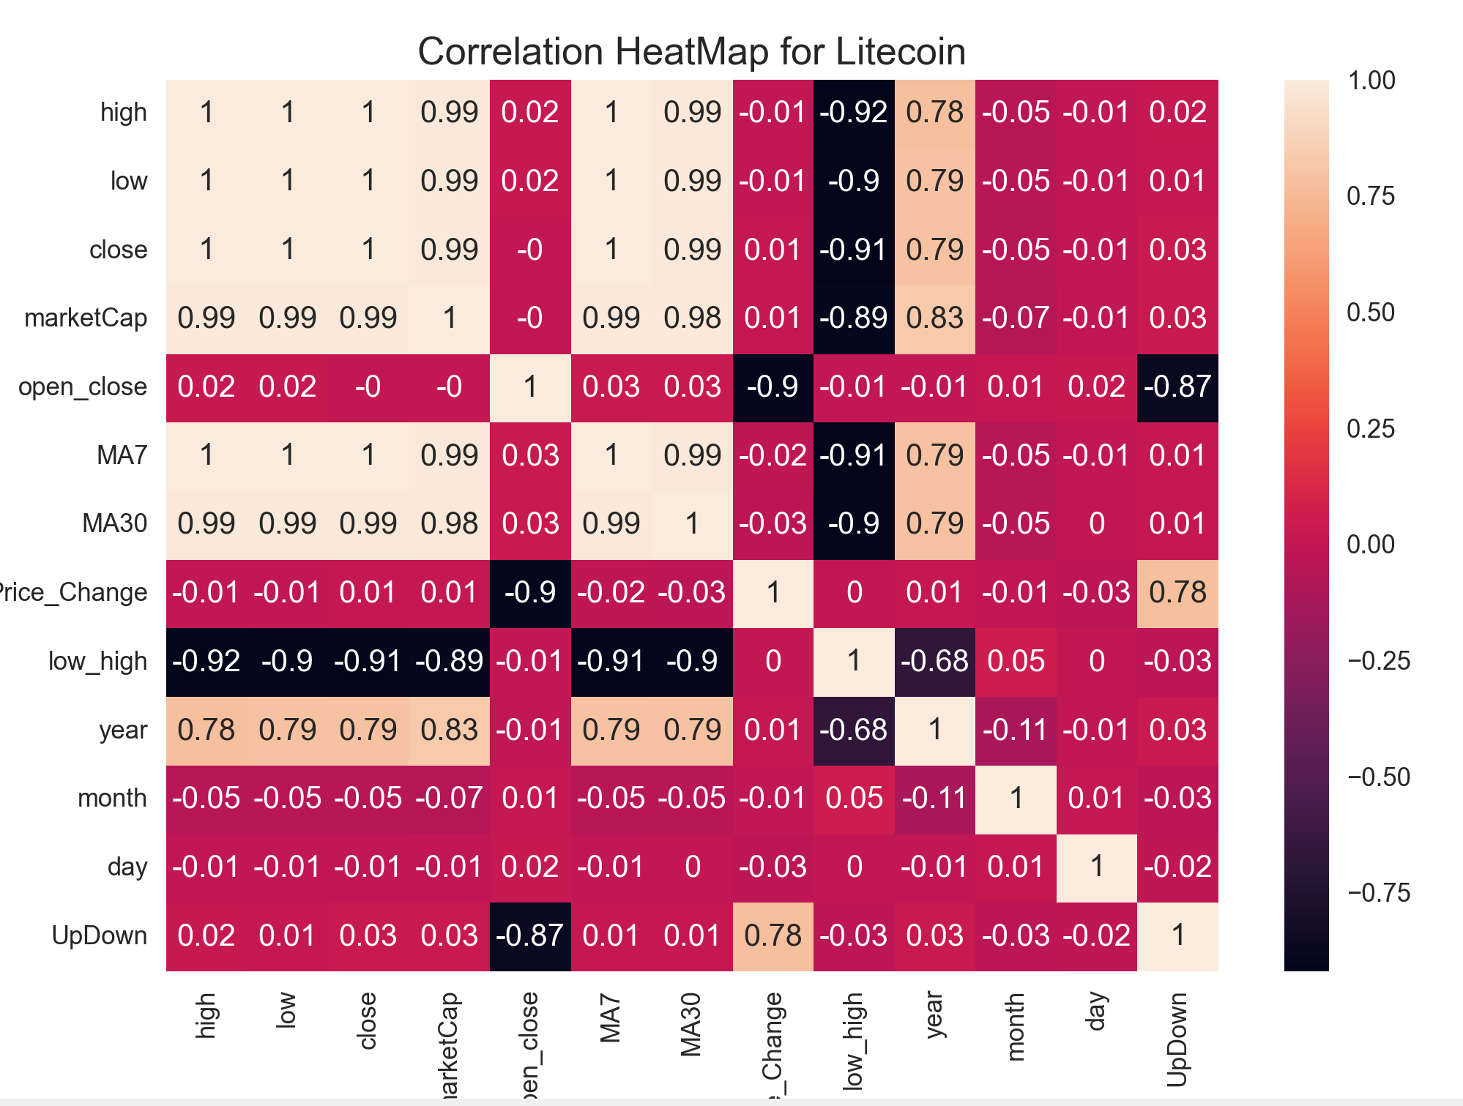
Constraints
Notes:
Ro - As you can see we have a very constrained dataset for an ambitious purpose, you can see our main features present multicolinearity which means we should select only one of this group but no more cause that might produce overfitting and issues to our models, you can see even after a rigorous data engineering the correlation between the dependen varaibles and independent variables is very small, except for those that have data leakage. This tell us that our model wont be able to deliver better predictions unless we bring new data to our model, for example we could add sentiment analysis to help predict a highly volatile asset as the cryptos, that would be helpful but the scope of this project was not aiming to that, and an interesting point is how our understanding has evolved since our last presentations, I think for most of us this was our first time building prediction models, and as we advanced on our courses of machine learning and stats we actually made sense of the things we were doing and why our models behave as they do.

Slide 19

What is streamlit?
Streamlit is an open-source Python library to create web applications for machine learning, data analysis, and other interactive tasks
It allows building and deploying web apps faster using simple Python scripts, without requiring knowledge of web development languages like HTML, CSS, or JavaScript
It simplifies the process of creating web-based applications, enabling faster prototyping and iteration
Notes:
Ro

Slide 20
Applications of Streamlit
Interactive Data Exploration:
-create interactive visualizations of data.
Model Evaluation:
-allowing users to analyze the model's performance easily by making a display of evaluation metrics.
Hyperparameter Tuning:
- can be used to create interfaces for hyperparameter tuning.
Model Monitoring:
- can also be used for monitoring machine learning models in production
Explainability and Interpretability:
- help in explaining machine learning models to stakeholders
Collaboration and Sharing:
- easy to share machine learning projects with others
Notes:
Ro - model monitoring: such as model accuracy, latency, and throughput, which allows to identify and troubleshoot issues fast.
by creating dashboards to track evaluation metrics
explainability: helping users understand how the model makes predictions.

Slide 21
Improvements
This workflow illustrate the logic of our code and its modularization
The code’s main function calls other functions such as data cleaning, data understanding, model building and metrics display.
MAIN
load_and_filterdata()
train_models()
Dashboard
clean_data()
ml_models
create_features()
display_classification_metrics()
Graphs
DataUnderstanding()
Notes:
Ro

Slide 22
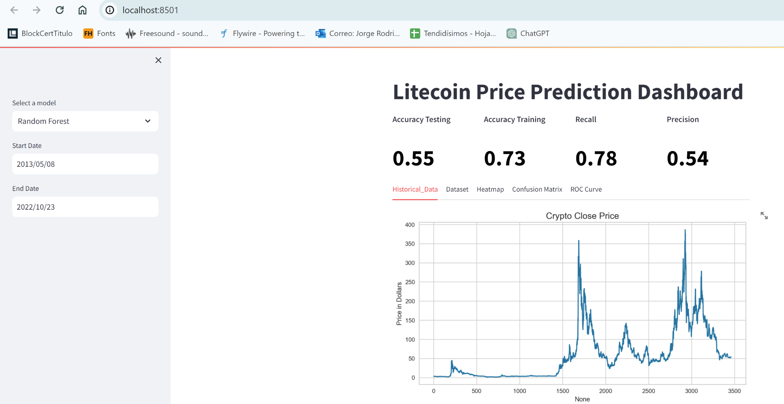

Dashboard
https://cryptocurrency-price-prediction-whrfmwvuvjhakbdqusrzet.streamlit.app/
Notes:
Ro
https://cryptocurrency-price-prediction-whrfmwvuvjhakbdqusrzet.streamlit.app/

